Slide 1
Lecture 9
Functional dependencies, normalization and normal forms

Slide 2
Relational schema design
Could be done by two approaches:
normalization theory:
Design method that utilize functional dependencies.
from conceptual schema
Application of transformation rules.
Note: Using transformation of conceptual schema, does not guarantee, that the resulting schema will be normalized! Simply because the conceptual schema itself can be not-normalized.

Slide 3
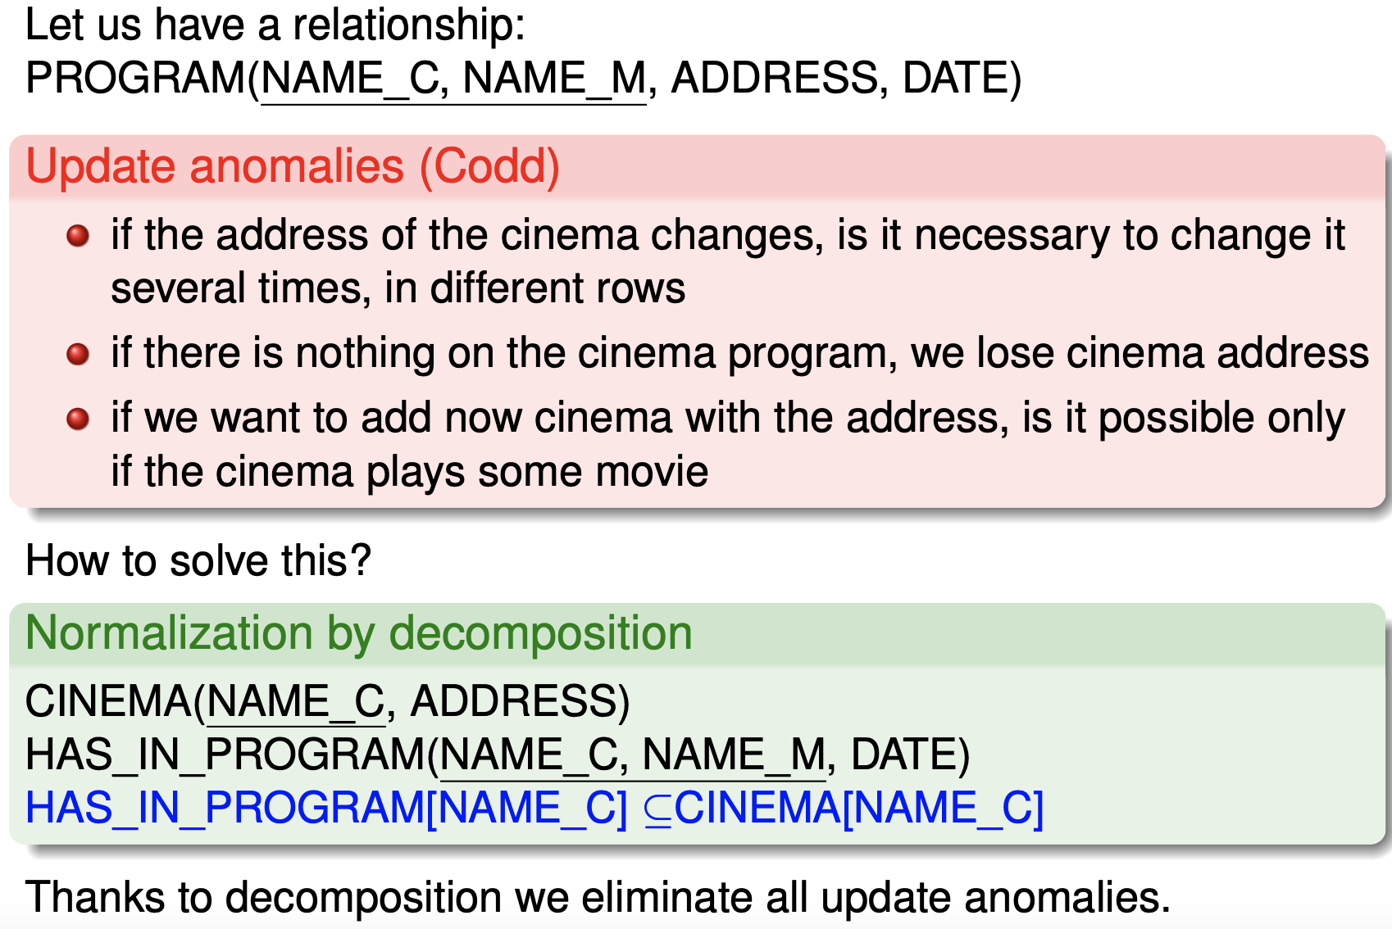
Quality of schema and normalization

Slide 4
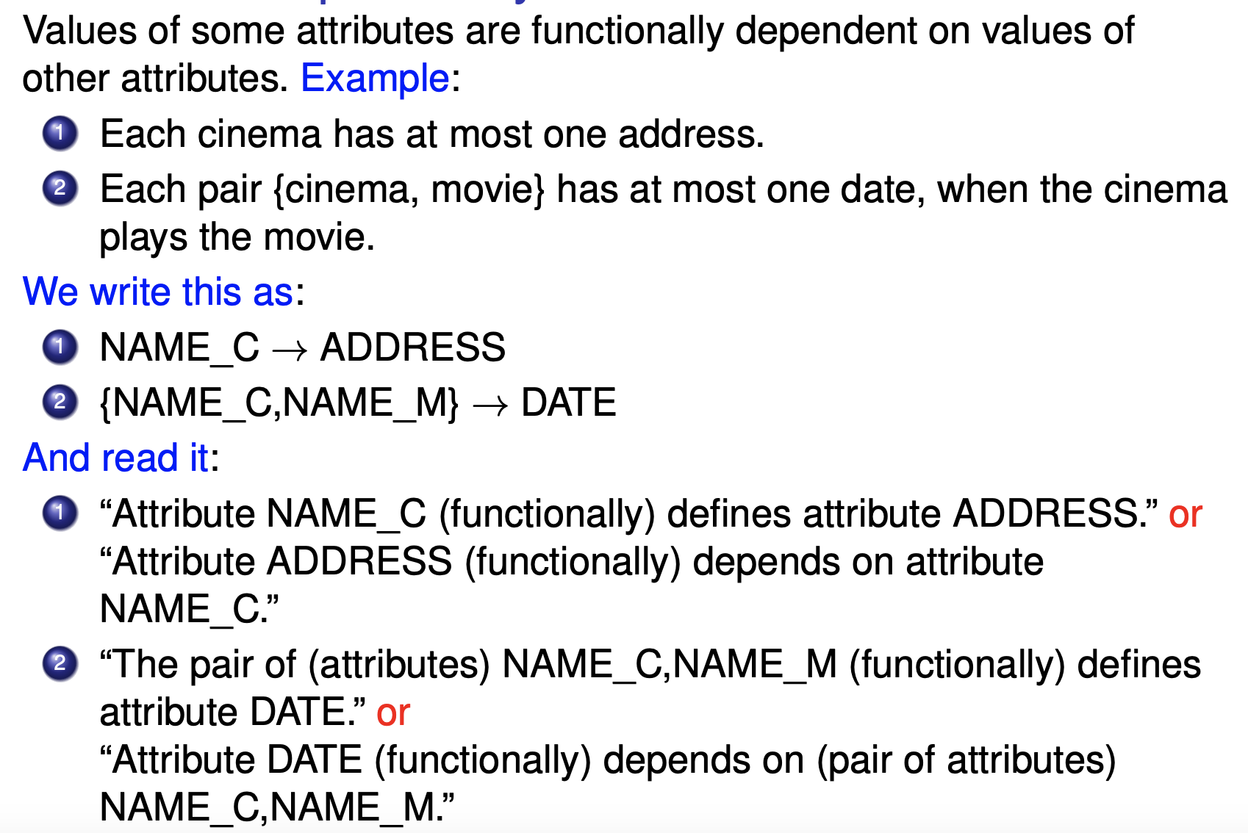
Functional dependency

Slide 5
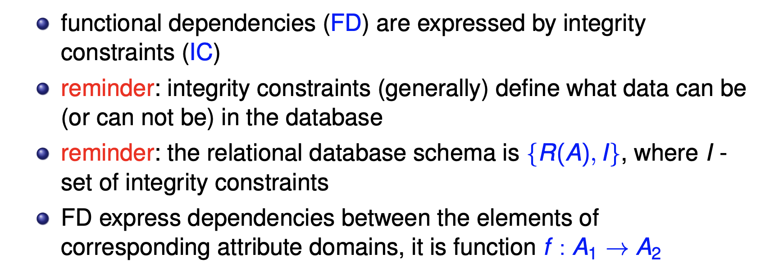
Functional dependencies – integrity constraints

Slide 6
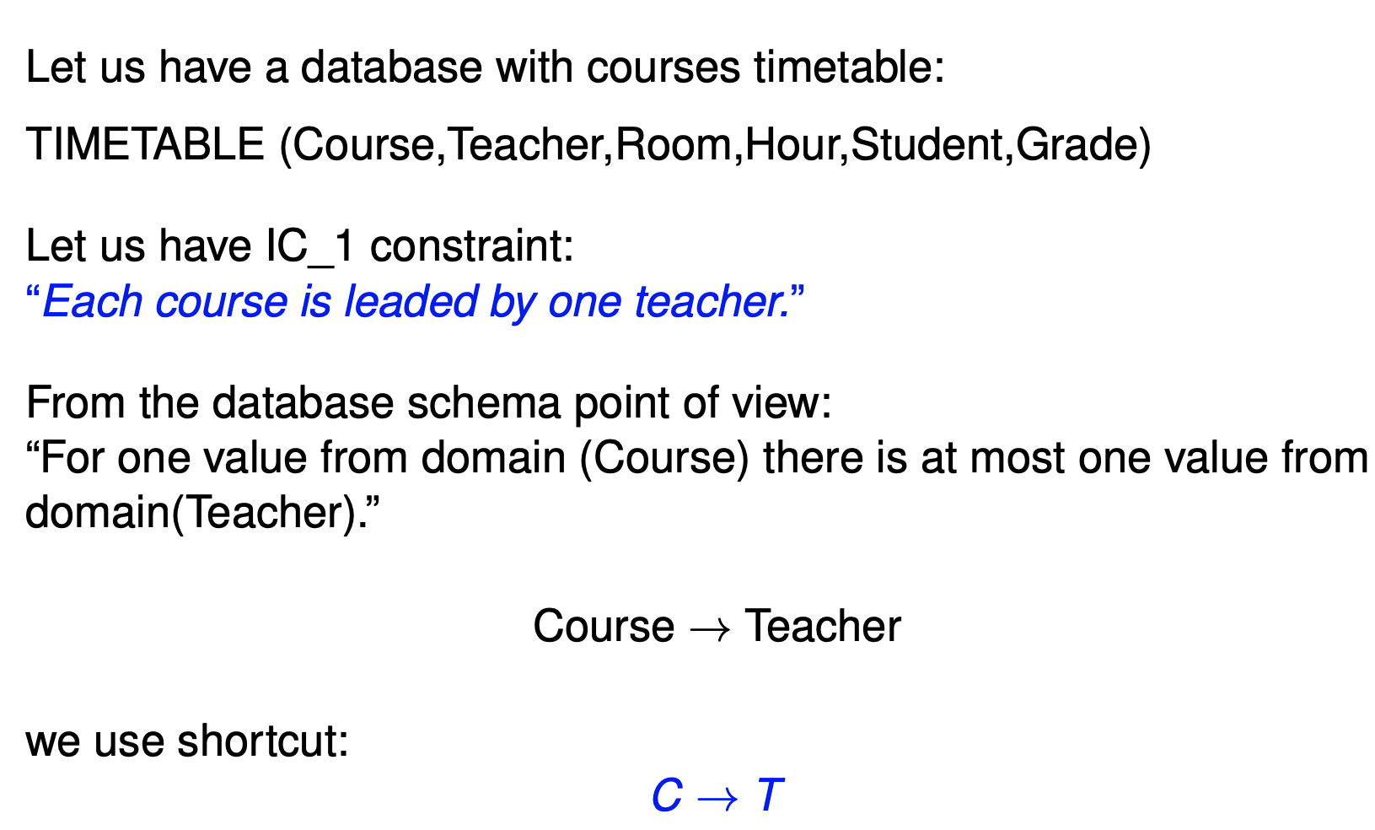
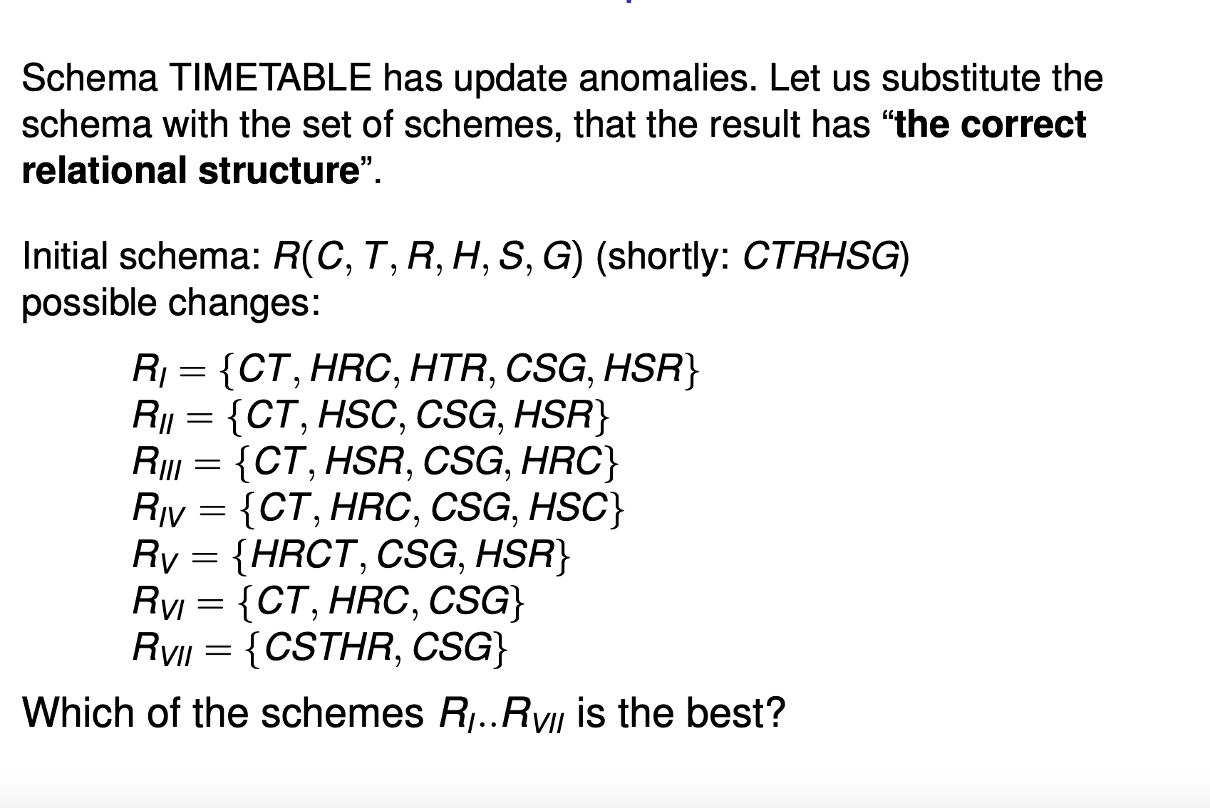
Schema correctness - example

Slide 7
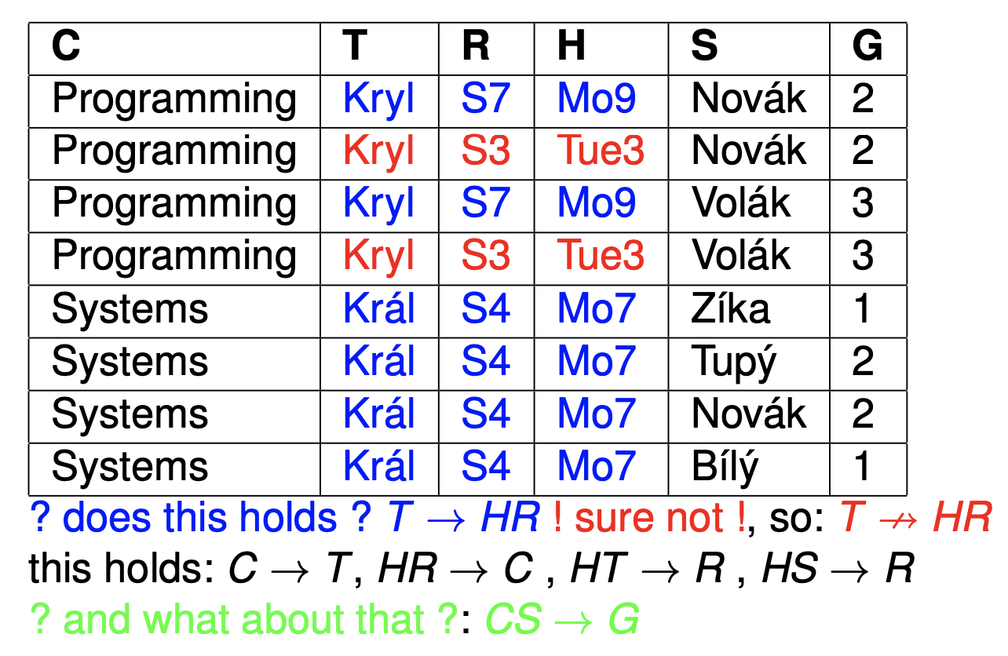
Discovering functional dependencies between
attributes

Slide 8
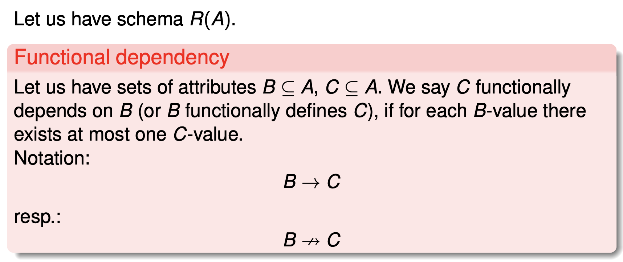
Functional dependency

Slide 9
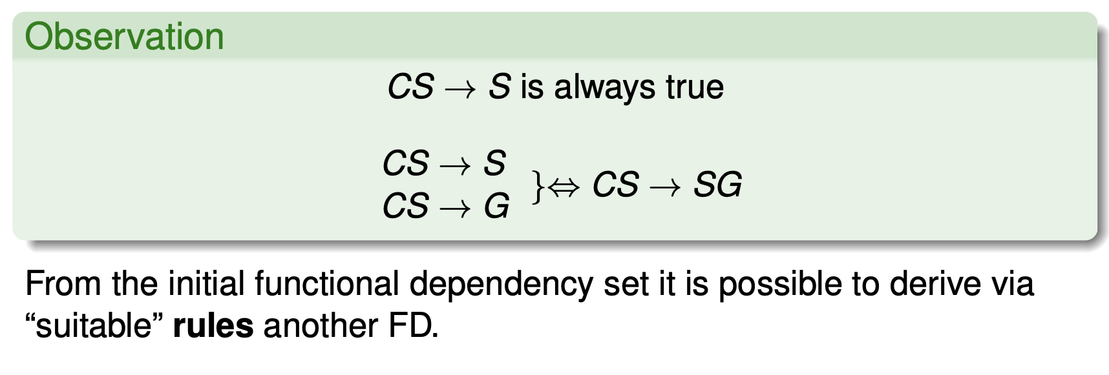
FD deriving

Slide 10
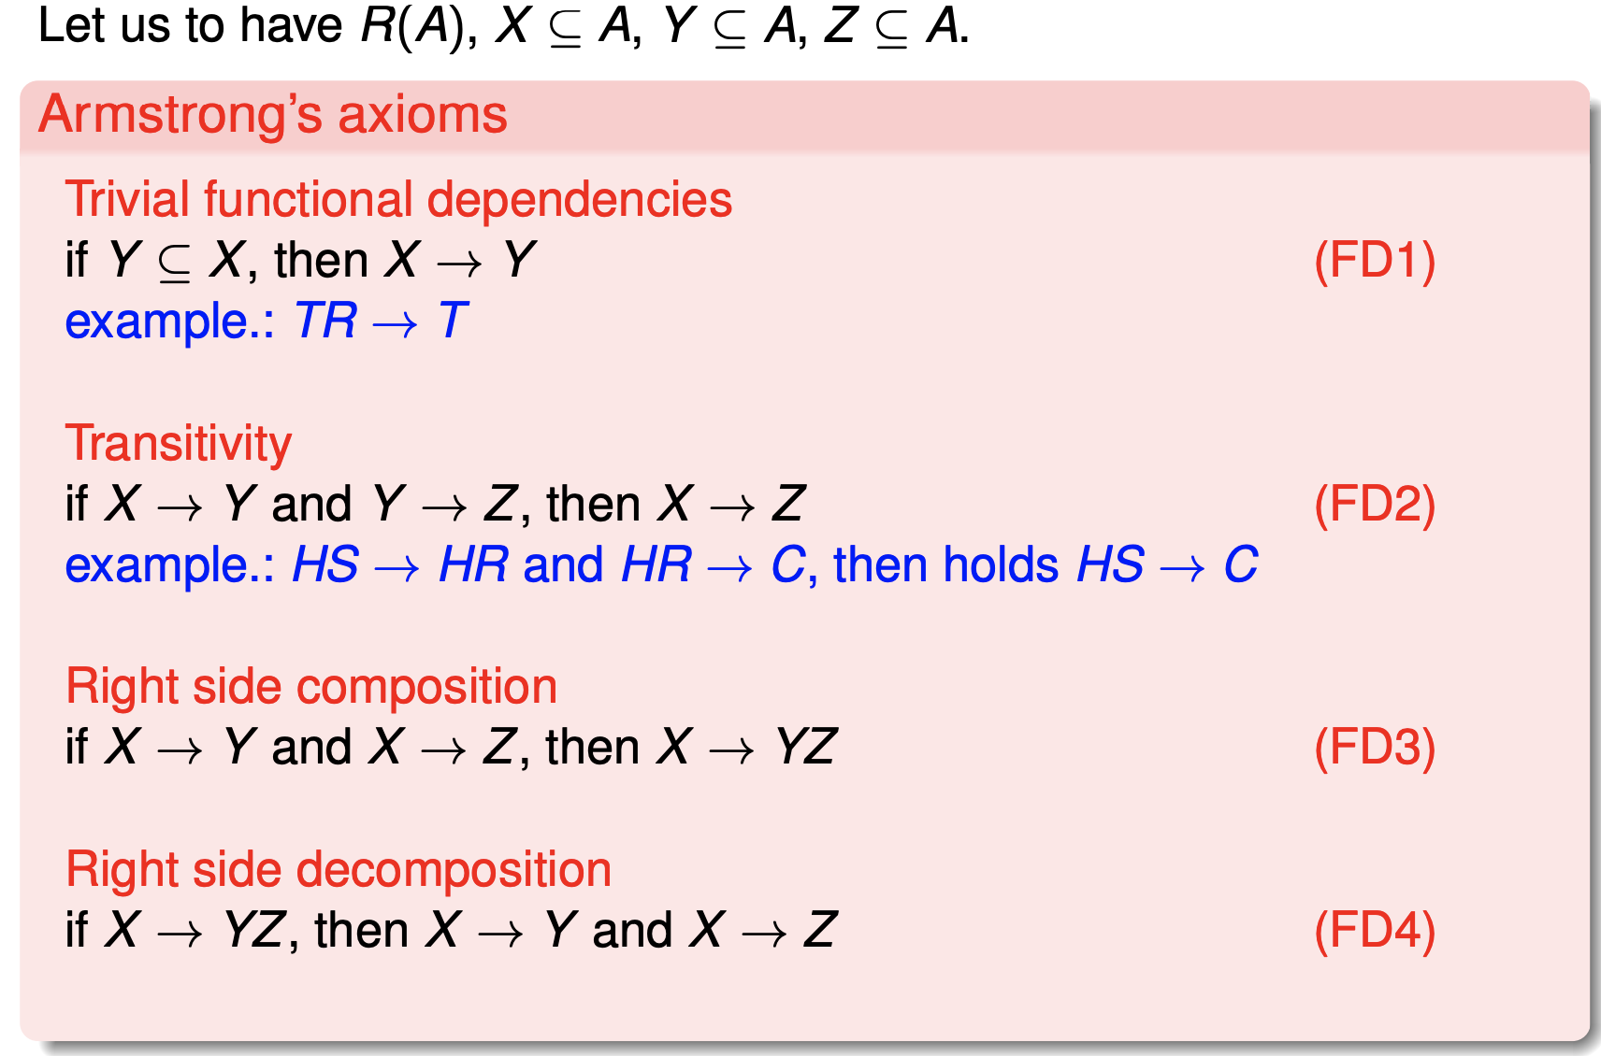
List of rules

Slide 11
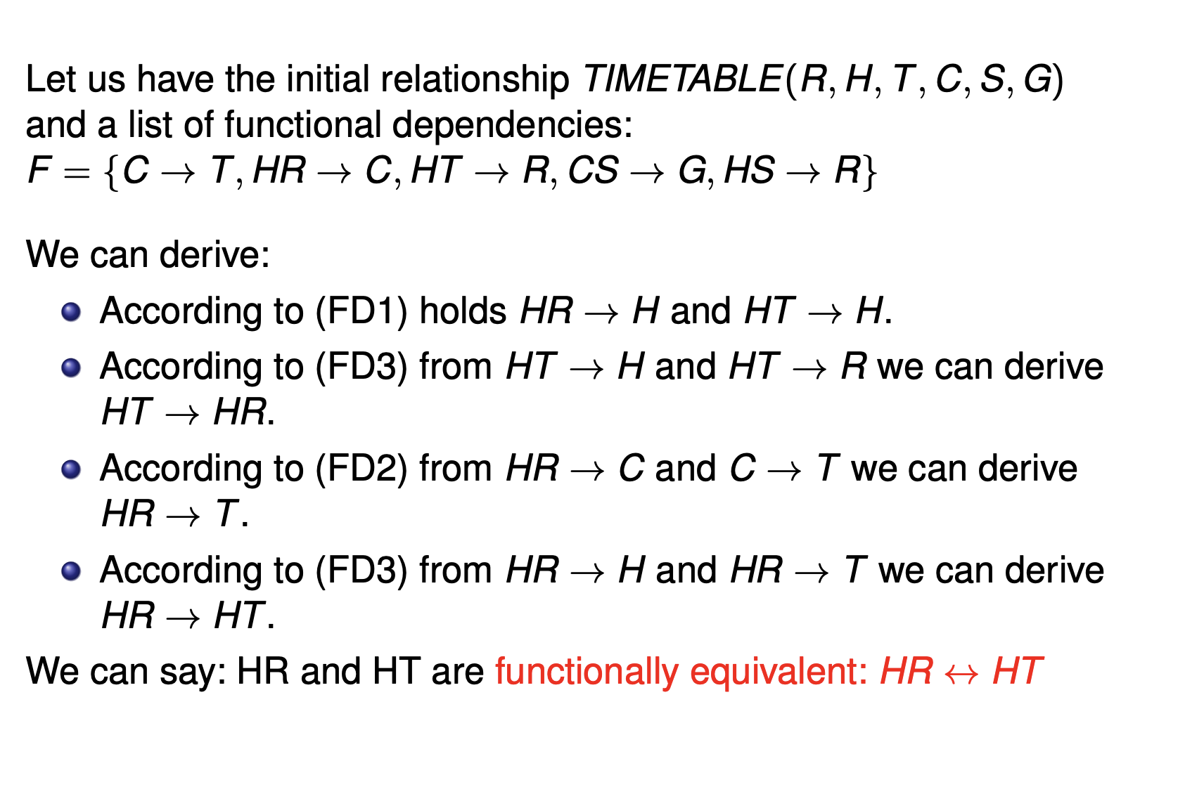
Using deriving rules

Slide 12
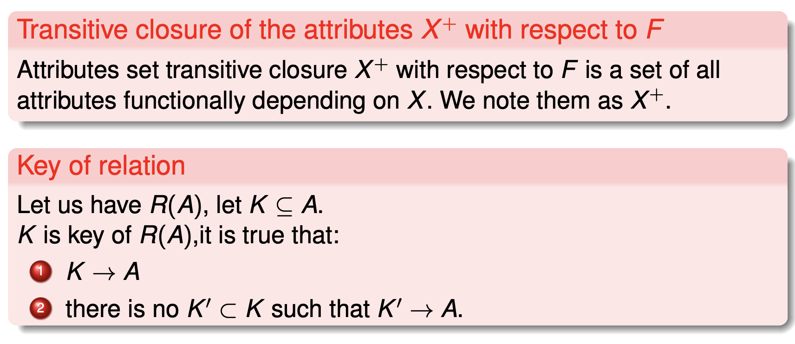
Transitive closure, key of relation

Slide 13
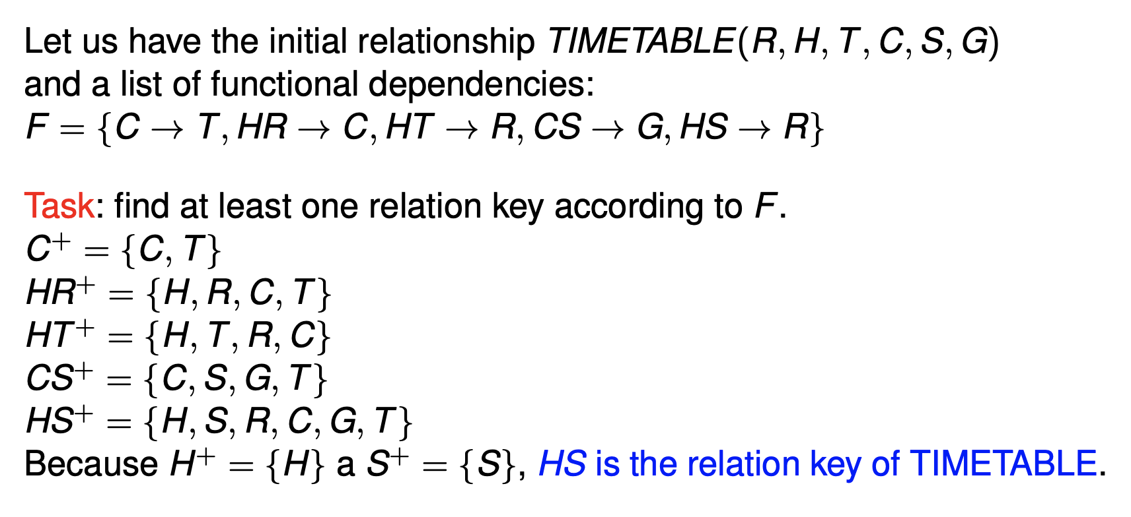
Example - searching the relation key

Slide 14
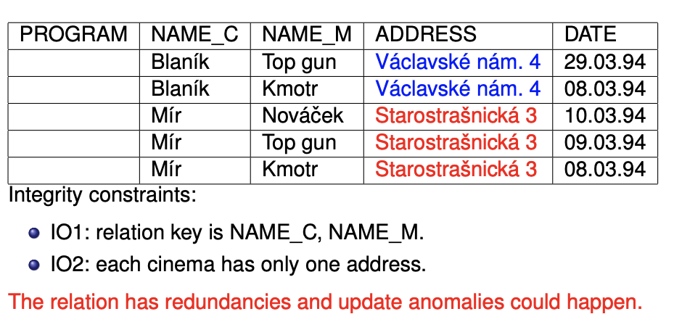
Normal forms

Slide 15
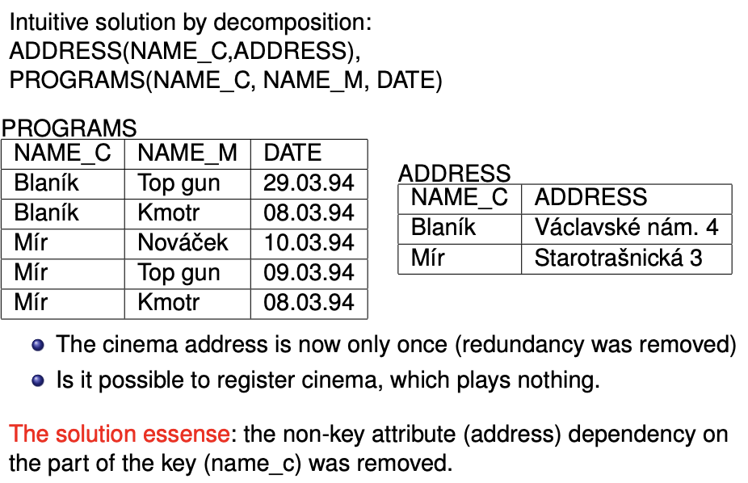
Normal forms

Slide 16
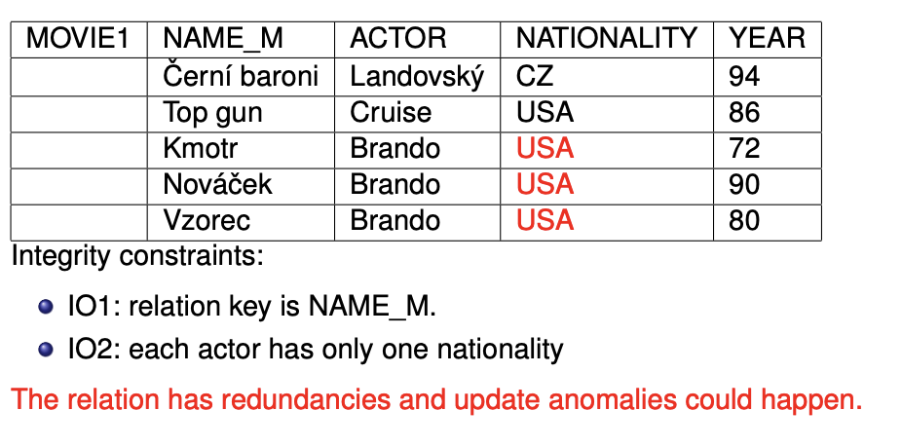
Normal forms

Slide 17
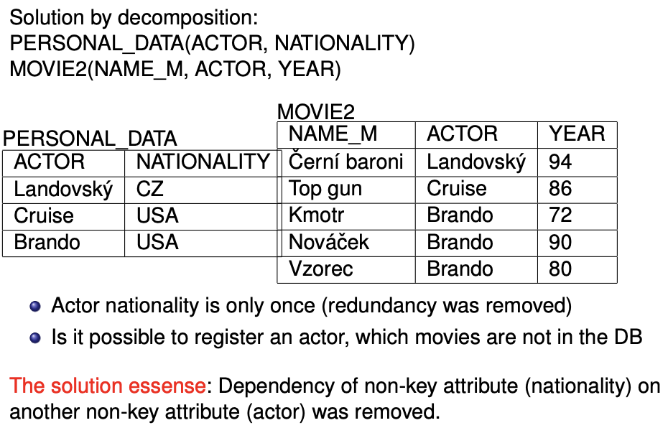
Normal forms

Slide 18
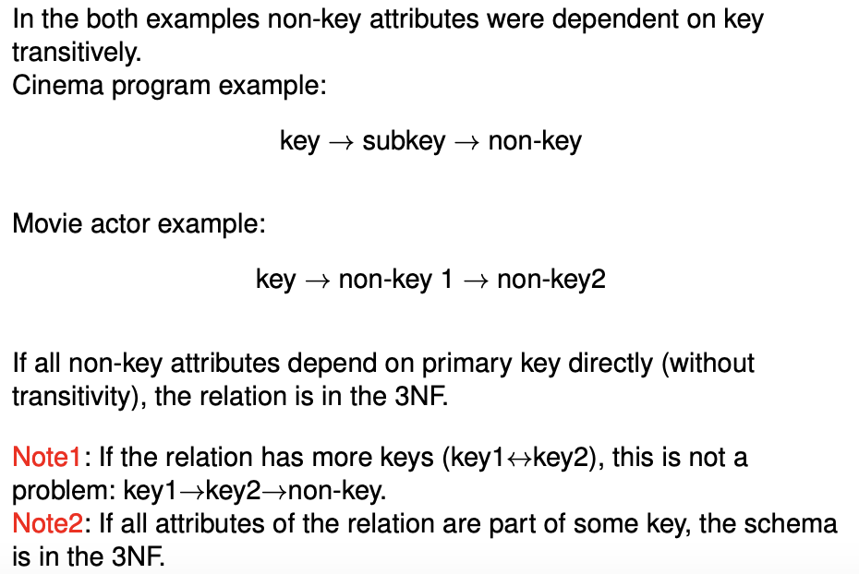
Normal forms – analysis

Slide 19
Normal form recapitulation
First normal form:
To satisfy First normal form, each column of a table must have a single value. Columns which contain sets of values or nested records are not allowed.
Second normal form
It is in first normal form.
It does not have any non-prime attribute that is functionally dependent on any proper subset of any candidate key of the relation. A non-prime attribute of a relation is an attribute that is not a part of any candidate key of the relation.
Third normal form:
The relation R (table) is in second normal form (2NF).
Every non-prime attribute of R is non-transitively dependent on every key of R.

Slide 20
Next forms
BCNF
Boyce–Codd normal form (or BCNF or 3.5NF) is a normal form used in database normalization. It is a slightly stronger version of the third normal form (3NF).
If a relational schema is in BCNF then all redundancy based on functional dependency has been removed, although other types of redundancy may still exist. A relational schema R is in Boyce–Codd normal form if and only if for every one of its dependencies X → Y, at least one of the following conditions hold
X → Y is a trivial functional dependency (Y ⊆ X),
X is a superkey for schema R.

Slide 21
Next form
Fourth normal form:
is a normal form used in database normalization. Introduced by Ronald Fagin in 1977, 4NF is the next level of normalization after Boyce–Codd normal form (BCNF). Whereas the second, third, and Boyce–Codd normal forms are concerned with functional dependencies, 4NF is concerned with a more general type of dependency known as a multivalued dependency. A table is in 4NF if and only if, for every one of its non-trivial multivalued dependencies X ↠ Y, X is a superkey—that is, X is either a candidate key or a superset thereof.

